Slide 1

Causality-Informed Fairness

Slide 2
CAUSALITY INFORMED FAIRNESS
Fall 2021 Capstone Project
Student Contributors:
Junzhi Ge
Mohammed Aqid Khatkhatay
Oscar Jasklowski
Xue Gu
Yue Wang
In Collaboration With JP Morgan:
Dr. Sanghamitra Dutta
Dr. Naftali Cohen

Slide 3
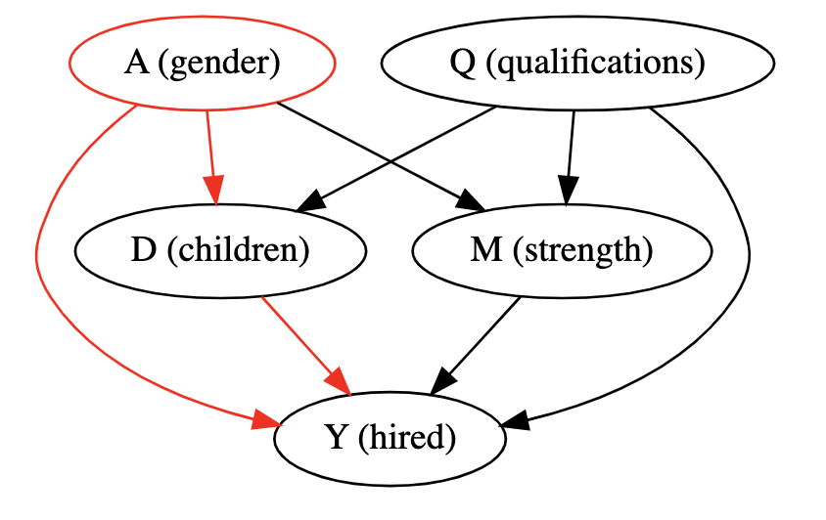
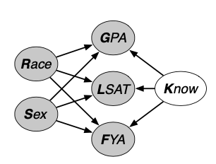
Context, Goal, Data Description
Motivation: Bias in existing data (with respect to a protected attribute like race) can give rise to biased ML predictors. We explore a variety of techniques to measure bias and account for it, resulting in “fair” classifiers.
Technical Goal: Compare the performance of a variety of causal inference-based fair prediction techniques.
Datasets and Casual Models
Synthetic “hiring” dataset
2. Law school success dataset
Figure 1. Synthetic “hiring” dataset depicts a fictional hiring process for a manufacturing job, where physical strength is an appropriate criterion for hiring, which is the target variable. Gender is the protected attribute in this context.
Figure 2. A real-world dataset for first-year law students, where FYA (first-year average), the target variable, is a measure of student success. Race and sex are the protected attributes in this context.
Notes:
Speaker notes:
Motivation:
Goal: research each causal model for unfairness in detail and to come with insights on its inner workings and performance through evaluation metrics. We also plan to thoroughly investigate which causal techniques and metrics should be used in what cases or types of data, whether the data generation process will be known or unknown. Statistically coming up with a framework for causally detecting bias will also be a key outcome in addition to the above goals and objectives.

Slide 4
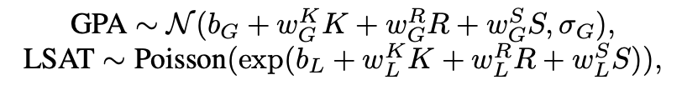
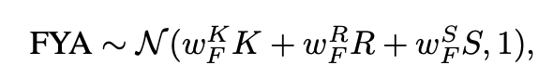
Modeling Approach & Model-Relevant Technical Insights
Prediction Model Type
Logistic Regression for classification (hiring outcome for synthetic dataset, FYA for law school dataset).
Models for Fairness Comparison
Baseline Unfair Model:
“Full” Model: defined as using available observable features from the causal graph for prediction
Fairness Techniques Implemented:
“Unaware”: same features as “full model” EXCEPT the protected attribute (sex/gender)
“Non-descendent”: same features as “unaware model” EXCEPT descendents of protected attribute
“Latent-variable inference”: Infer a node that is not a descendant of protected attributes.
“Path-specific”: All non-protected attributes (and descendents) and allowed components of protected paths.
“Fair Inference on Outcomes” (FIO): build counterfactual model based on fair descendant.
Technical Insights
Latent-variable: By making assumptions on observable variables, we would be able to get a fair variable based on learning a posterior distribution.
Path-specific: By minimizing the upper bound of PIU (probability of individual unfairness) estimated from data (SCM specified) , path-specific unfairness causal effect is removed at an individual level.
FIO: Use PSE and MLE method to find best distribution of ‘outcome’.
Notes:
MODELS notes:
Unaware: While “fairness through awareness” may be an intuitive idea, it has limited usefulness. The idea is to simply omit the protected attribute when building a predictive model. However, because other attributes in the causal graph can be descendents of a protected attribute (e.g. home address can often be a descendent of race), simply removing a protected attribute may not remove its effect.
Latent variable inference: We want to find the variable that is completely not affected by the protected attribute, but is a parent of all other variables. We assume there is a latent variable that’s not observable but has an impact on Y. We would like to learn the distribution of the variable by excluding the effect of all other variables on Y.
Path-Specific: [Alice] By minimizing the upper bound of PIU (probability of individual unfairness) estimated from data (SCM specified) , path-specific unfairness causal effect is removed at an individual level. Prediction is made on top of the minimization constraint using a simple neural network model.
FIO: [Aqid + Junzhi] We want to find fair outcomes, first we need to find PSE(path-specific effect), then we find maximum likelihood distribution to optimize counterfactual ‘outcomes’ with constraints on PSE, then we use logistic to figure out the prediction using certain threshold.
INSIGHTS notes:
Latent variable: By making assumption of observable variable, we would be able to learn a fair variable based on learning a posterior distribution. It should be the most fair predictor. It is achieved by Stan Package in R.
Path-Specific: [Alice] No impractical assumption is needed. SCM needed (I think but there might be a way around it). Compared to PSCF (path-specific counterfactual fairness, our original assigned paper), we only need estimation of marginal potential outcome probabilities is and it’s easy to compute.
FIO: [Aqid Junzhi] The FIO give a easy way to optimize counterfactual ‘outcomes’ using distribution and path-specific effects because we only need original data. Also it can fit different models without finding external path or latent variables but focus directly on outcomes.

Slide 5
Summary of Key Results
In general, we observe a tradeoff between prediction accuracy and our fairness metrics.
The principal exception is the path-specific fairness technique; relatively high accuracy, highest fairness. This is because the model can decompose a causal path into fair and unfair components, using information from only the fair component.
Synthetic Hiring Dataset
Model | Prediction Accuracy | ETT¹ | Counterfactual Fairness²
Full | 99.55% | 0.1075 | 0.2681
Unaware | 97.30% | 0.0990 | 0.2469
Non-descendant | 87.80% | 0.0000 | 0.0000
FIO | 87.60% | 0.0200 | 0.1240
Path-specific | 89.70% | 0.0152 | 0.0152
Law School Dataset
Model | Prediction Accuracy | Probability of Female Success | Probability of Male Success
Full | 84.84% | 11.58% | 15.27%
Unaware | 84.60% | 11.53% | 15.19%
Non-descendant³ | NA | NA | NA
Latent-variable | 81.34% | 11.56% | 14.95%
1. ETT (effect of treatment on the treated) measures difference in outcome by taking the absolute difference between counterfactual and factual.
2. Counterfactual fairness, a fairness metric, measures the aggregate effect in a counterfactual world where all is equal except protected attribute.
3. All attributes in this causal model are either protected or descendents of protected attributes. Therefore, no set of observed “fair” attributes exists.
Notes:
Speaker notes:
Did you solve the problem?
Yes, in general, more advanced techniques (especially path-specific fairness and fair inference on outcomes) improved our fairness metric.
However, there are two main drawbacks of these techniques. In general, with more advanced techniques:
Prediction accuracy is reduced, and
These techniques are high-effort (implementation depends on model DGP specifications, and these cannot be trivially swapped in these implementations)
Which work enabled this? Intuition behind our techniques / why we think we got these results
Path-specific fairness: [2-3] sentences of intuition behind this technique
FIO: We find counterfactual distribution of data using PSE we calculated with original data, then we maximize the distribution to find and ‘outcome’, we could use that to predict. As unaware model discard those protected attributes, FIO would find distribution based on MLE method and actually make use of all attributes of datas during computation.
What work remains to be done?
Generally speaking, we would like to compare the effectiveness of these techniques across more real-world datasets.
Path-specific: apply to real-world datasets, explore conditional independence relations and the graphical condition on unfair pathways π in the real world datasets, which might require advanced techniques such as structural learning.
FIO: the technique can only be applied to datasets which have non-sensitive observed variables. Therefore, applying this technique to such a dataset (for example, the German credit dataset), would be a reasonable next step.

